Slide 1
Morphological Image Processing

Slide 2
Basics
Once image segmentation is complete, morphological operations can be used to remove imperfections in the segmented image, and
Provide information on the form and structure of the image
Chapter Contents:
Structuring element
Erosion, Dilation
Opening, Closing
Chapter Exercise:
Get outline of an object in an image

Slide 3
Structuring Element
Structuring element is like kernel used for image filtering
It can be of any size and shape
However, for simplicity we will use rectangular structuring element with their origin at the middle pixel
0 | 0 | 1 | 0 | 0
0 | 1 | 1 | 1 | 0
1 | 1 | 1 | 1 | 1
0 | 1 | 1 | 1 | 0
0 | 0 | 1 | 0 | 0
1 | 1 | 1
1 | 1 | 1
1 | 1 | 1
0 | 1 | 0
1 | 1 | 1
0 | 1 | 0

Slide 4

Erosion - Example
Erosion by 5*5 square structuring element
Original image
Erosion by 3*3 square structuring element

Slide 5
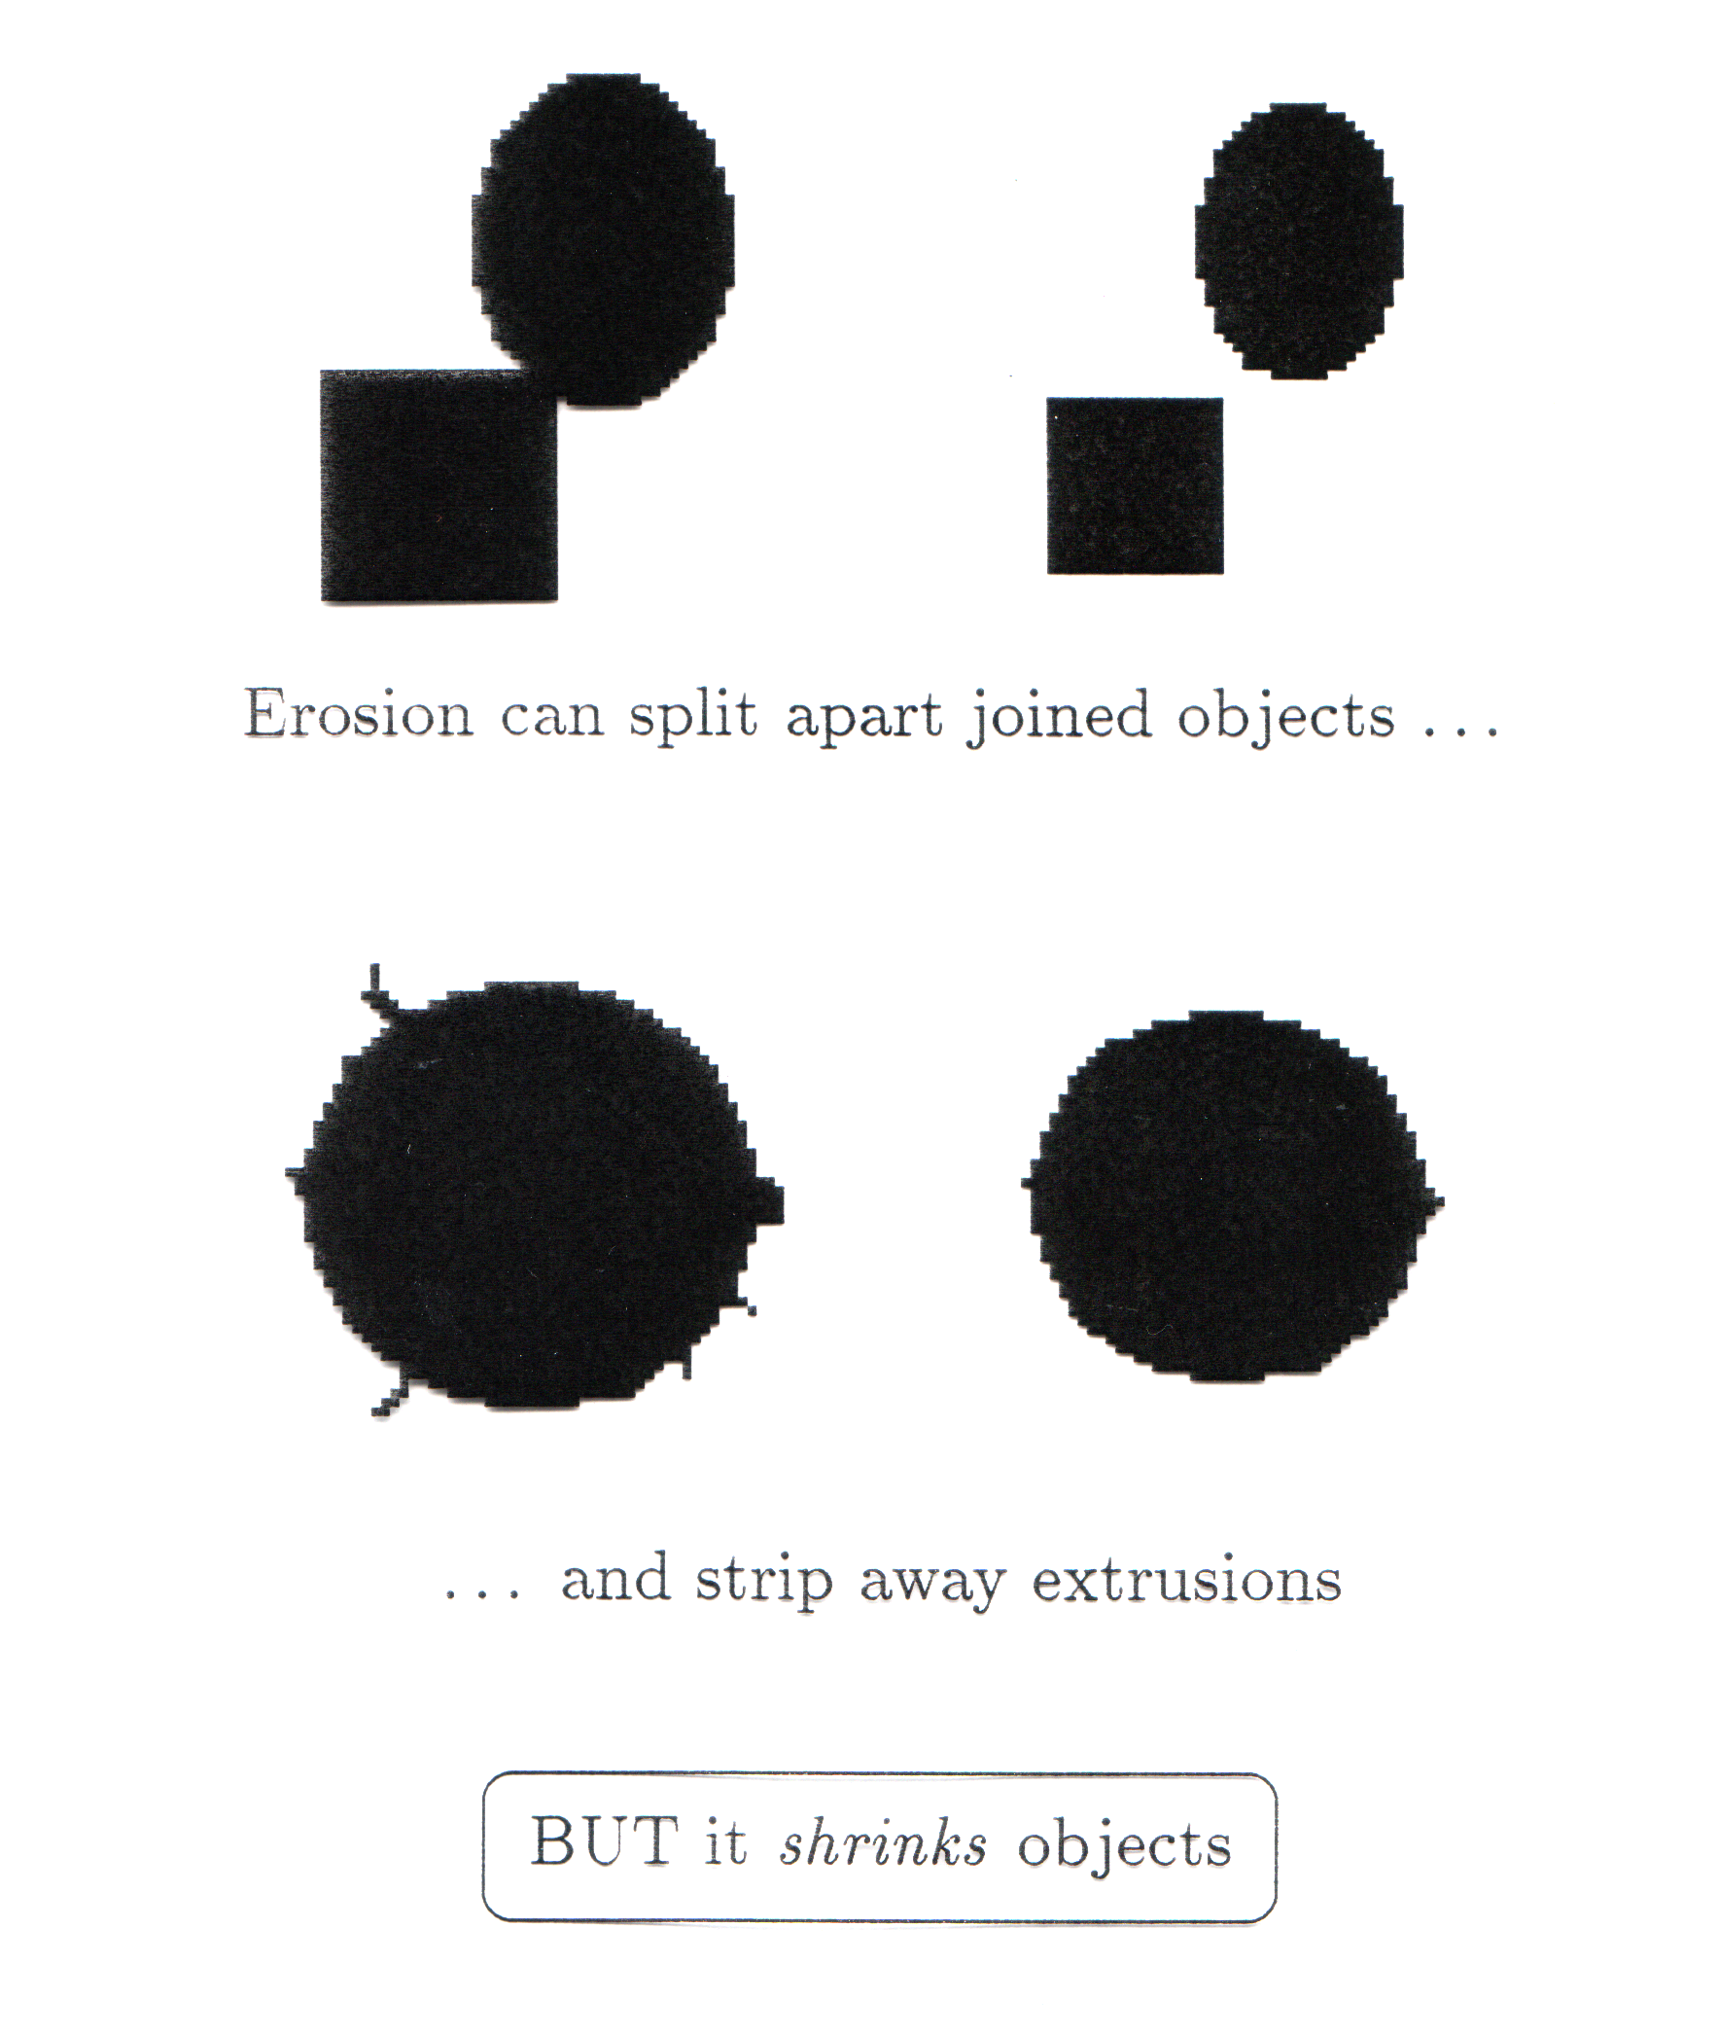
What Is Erosion For?
Erosion can split apart joined objects
Erosion can strip away extrusions
Watch out: Erosion shrinks objects

Slide 6

Dilation - Example
Dilation by 3*3 square structuring element
Dilation by 5*5 square structuring element
Original image

Slide 7
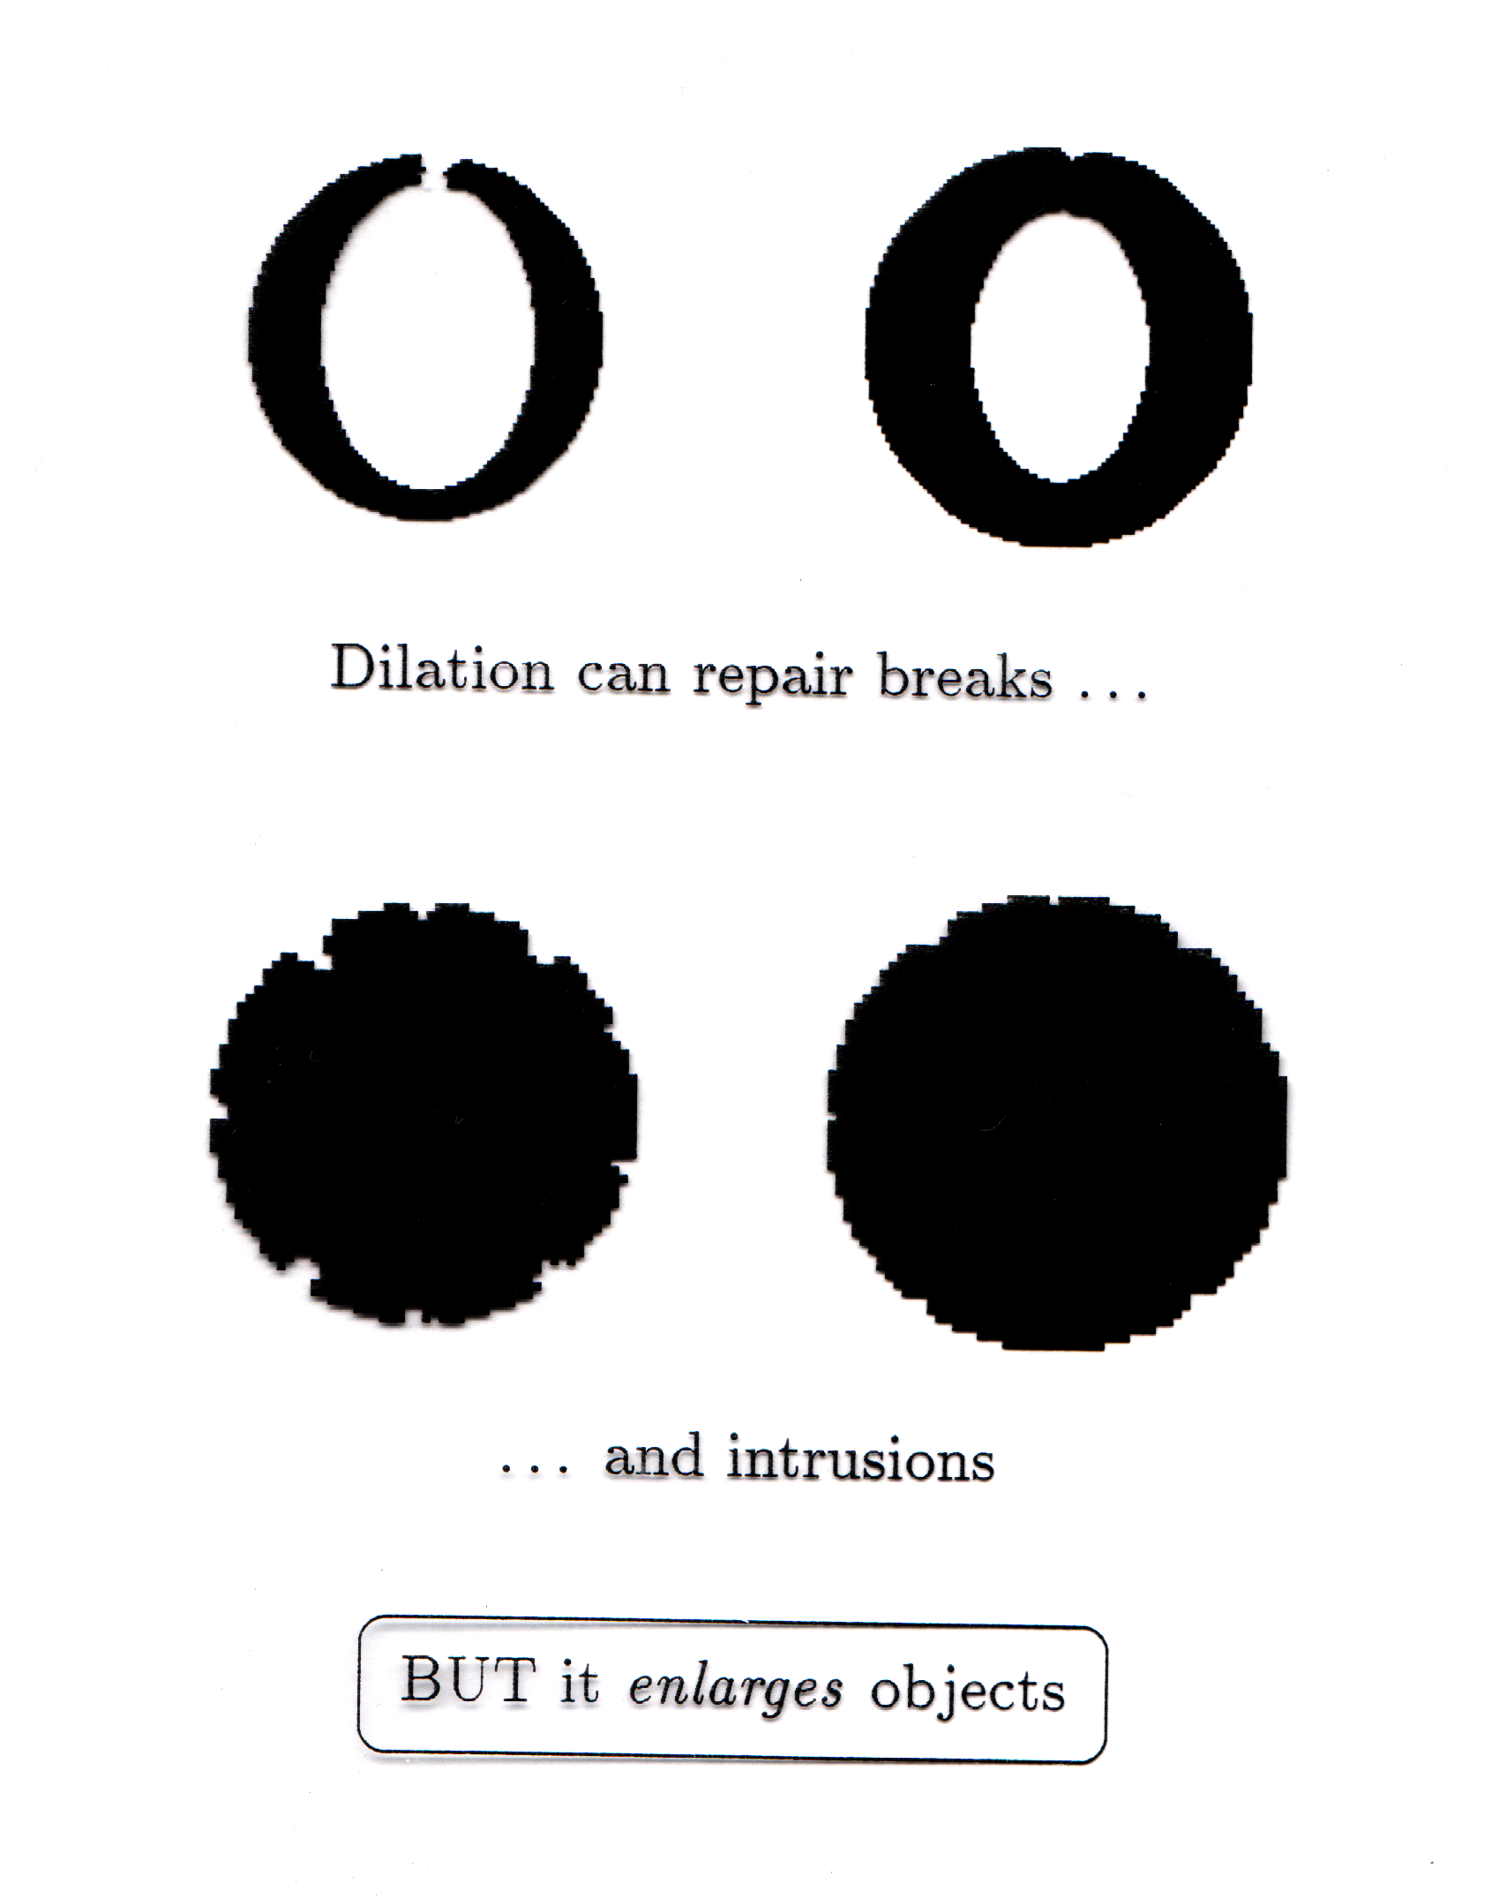
What Is Dilation For?
Dilation can repair breaks
Dilation can repair intrusions
Watch out: Dilation enlarges objects

Slide 8
Compound Operations
Image Opening
Erosion followed by a dilation
Image Closing
Dilation followed by an erosion

Slide 9

Opening Example
Original Image
Image After Opening

Slide 10
Closing Example
Original Image
Image After Closing

Slide 11
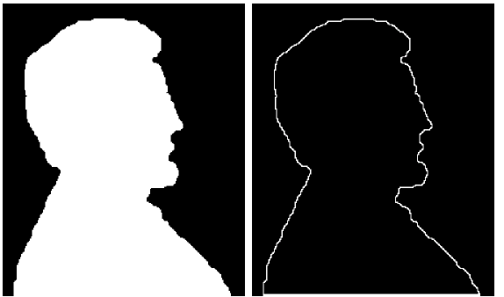
Boundary Extraction Example
A simple image and the result of performing boundary extraction using a square 3*3 structuring element
First erode the original image and then subtract the eroded image from original image to get object boundary
Possible using dilation also: THINK ABOUT IT
Original Image
Extracted Boundary

